Slide 1
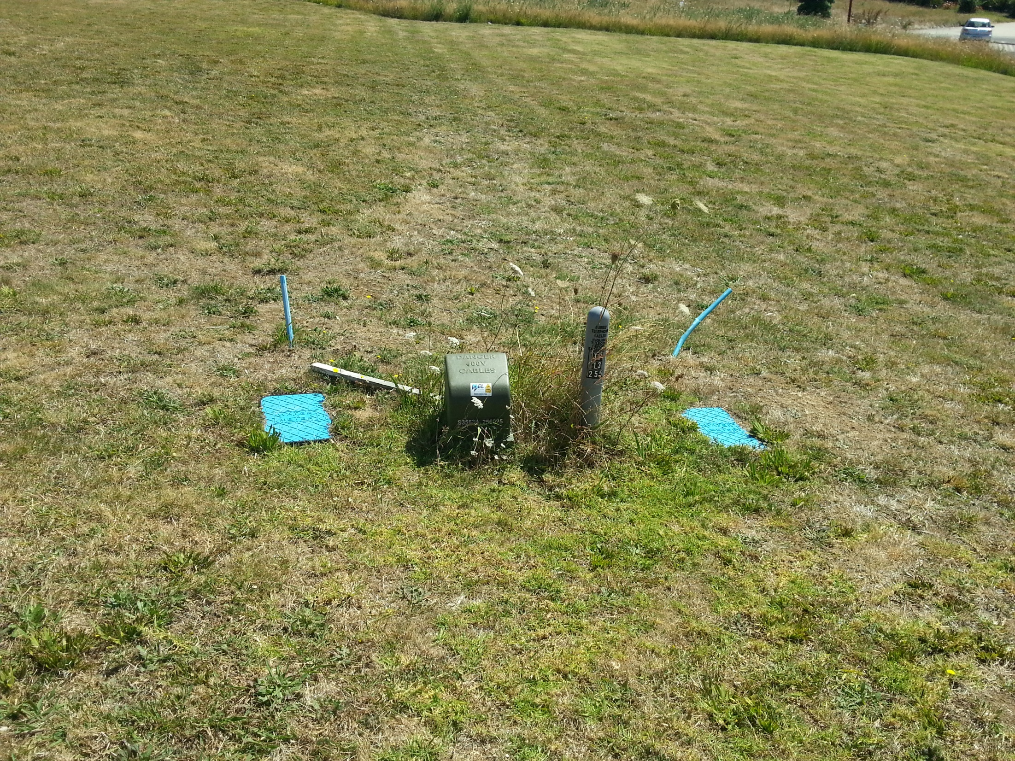
The laws
1

Slide 2
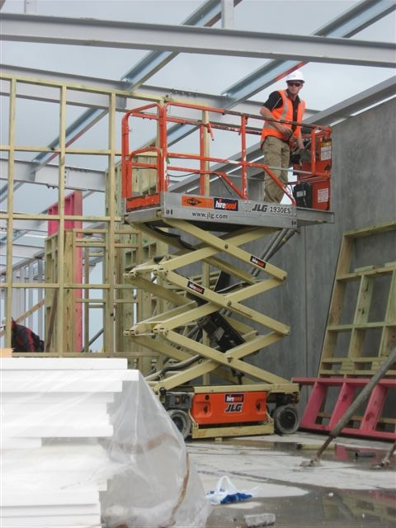
In this presentation:
Introduction
The Laws
The Health and Safety in Employment Act (HSE Act)
The Building Act
Other Useful Laws

Slide 3
Introduction
Any place of work can have associated hazards and dangers that can cause harm to people

Slide 4
In New Zealand in 2012:
102
People died at work
378
People injured at work
$3.5b
Total social and economic cost of deaths and injuries at work

Slide 5
Introduction
Cont..
The construction industry
The construction industry has a particularly dangerous working environment.
Look at the following images and discuss the dangers you see.

Slide 6
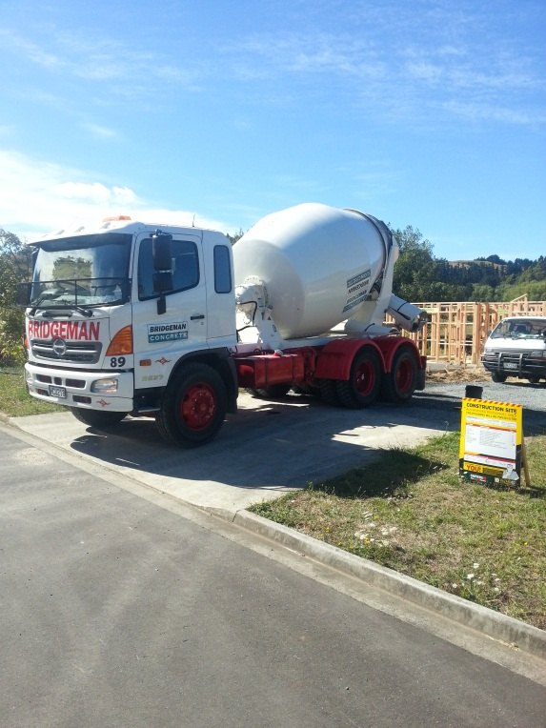
1
2

Slide 7
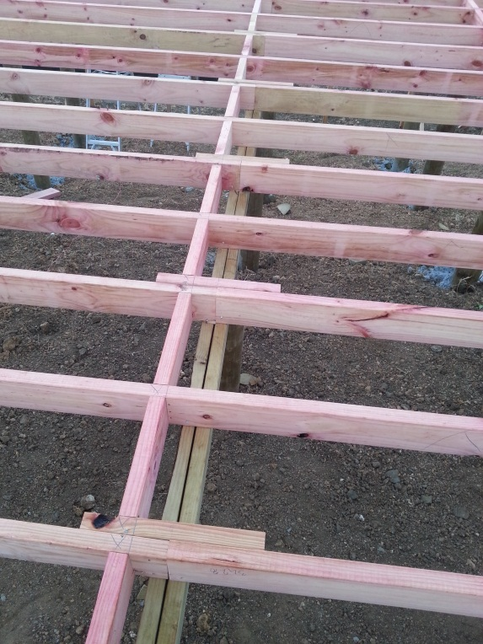
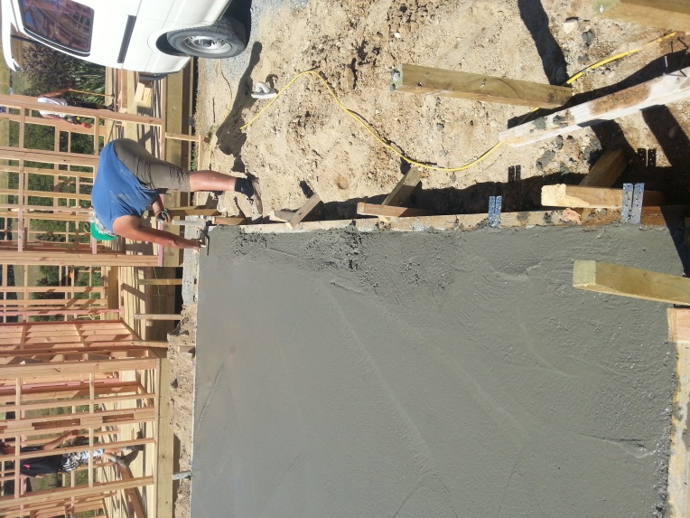
3
4

Slide 8
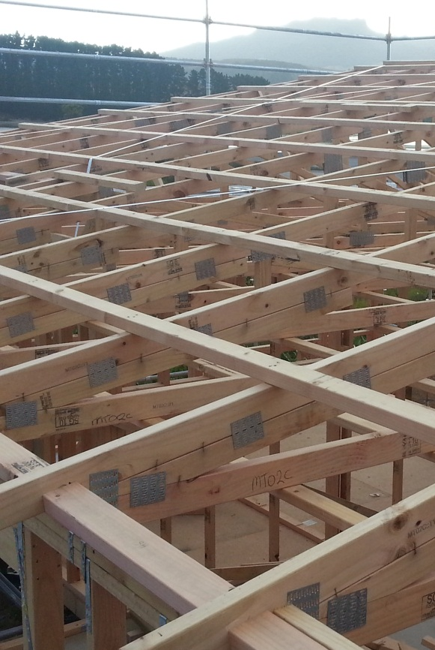
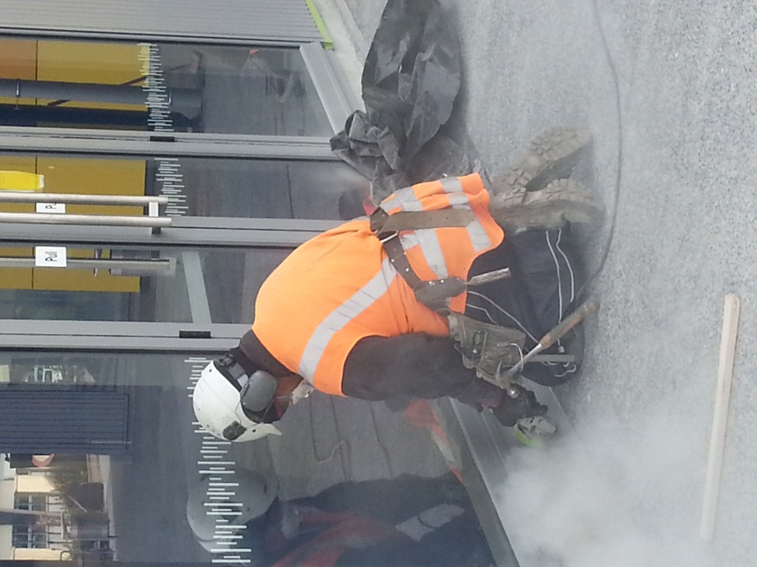
5
6

Slide 9
How would you complete this sentence? What can be done?
Talk about this in class.
The construction industry has a particularly dangerous working environment. By understanding what health and safety is all about, we can …
Notes:
In this manual we will look at safety legislation, regulations, codes of practice and the guidelines relevant to the construction industry.

Slide 10
The laws
In New Zealand, there are a lot of laws that keep people safe. Many laws are written statements.
Notes:
They can be quite difficult to understand, but here is a simple way of looking at the different types of law.

Slide 11
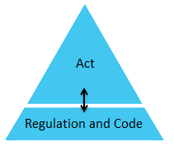
Act:
An Act is law passed by Parliament. Most Acts have a government department to make sure they are followed.
Regulation and Code:
Government departments create regulations and codes that are specific to an Act passed by Parliament.
Regulations and codes are more specific laws or statements that describe how an act should be implemented or followed.
Notes:
but here is a simple way of looking at the different types of law.

Slide 12
The Health & Safety in employment Act (HSE)
The law to make sure you are safe at work.
The emphasis of the law is on the systematic management of health and safety at work.
Notes:
The law to make sure you are safe at work is called the Health and Safety in Employment Act 1992. The Health and Safety in Employment Act 1992 can be shortened to HSE Act.
Systematic management of health and safety at work
An organised and orderly way of managing health and safety issues at work. For example:
Are there workplace safety rules to follow?
What are the steps of reporting an accident?
Who is in charge of health and safety in a work place?

Slide 13
The Health & Safety in employment Act (HSE)
It requires employers and others to manage safe working environments, and implement sound practice.
It recognises that successful health and safety management is best achieved through good faith co-operation in the place of work and, in particular, through the input of those doing the work.

Slide 14
DOL
Government department responsible for making sure the HSE Act is followed
Department of Labour
Promotes the prevention of harm to all people at work, and others in, or in the vicinity of, places of work
Main goal and objective of the HSE Act
All New Zealand workplaces place duties on employers, the self-employed, employees, principals and others who are in a position to manage or control hazards
People and places the HSE ACT is for
Notes:
Here is a snap shot of the law

Slide 15
The Health & Safety in employment Regulations
These regulations contain more detailed provisions that ‘fill in’ the duties and responsibilities outlined in the Act,
including minimum standards that must be met by employers to ensure that they have taken ‘all practicable steps’ to protect health and safety.

Slide 16
The HSE Regulations include:
Requirements applying to all workplaces covering washing facilities, fresh air, lighting, drinking water and emergency exits
Duties of manufacturers and designers or suppliers of plant or protective equipment
Certificates of competence for those involved with high risk activities such as diving or construction
Notifiable hazardous activities (i.e. scaffold 5 metres or higher)
Managing particular hazards such as noise, working at height, or with loose materials.

Slide 17
The Health and Safety in Employment (HSE) law in New Zealand
HSE Act
1992
NZ Parliament
HSE Regulation
Department of Labour

Slide 18
The Building Act:
In New Zealand, the Building Act 2004 sets out the law on Plumbing work, it is about ensuring that systems are designed and built right from the start.

Slide 19
DBH
Government department responsible for making sure the Building Act is followed
Department of Building and Housing
Introduced to improve building controls and building practices in the New Zealand building industry
Main goal and objective of the Building Act
All New Zealand building workplaces, employers, the self-employed, employees, principals and others in the building industry
People and places the Building ACT is for
Notes:
Here is a snap shot of the law

Slide 20
The New Zealand Building Code:
The New Zealand Building Code sets out performance standards all Plumbing work must meet. It covers aspects such as:
Water Supplies
Foul water
Surface water
Moisture control
Personal Hygiene
All new Plumbing work must comply with (follow) the building code, which makes provision for the requirements of the building, including the safety of users.

Slide 21
The Building Act 2004
The Building law in New Zealand
NZ Parliament
The Building Code
The Department of Building and Housing
Notes:
We can now add new information to our law diagram for building

Slide 22
Does the Building Act cover the health and safety of Plumbers at work?
Which act covers the health and safety of Plumbers at work?

Slide 23
Other Useful Laws
Plumbers/drainlayers must also be familiar with the following two laws.

Slide 24
The Resource Management Act
The Resource Management Act (usually called the ‘RMA’) is New Zealand’s main law that sets out how we should manage our environment.

Slide 25
Min En, DC
Government department responsible for making sure the Resource Management Act is followed
Ministry of Environment Department of Conservation
To encourage all people of New Zealand to manage natural resources and plan for the future of the environment in way which enables people and communities to provide for their social, economic and cultural wellbeing and for their health and safety
Main goal and objective of the Resource Management Act
All people and work places of New Zealand
People and places the Resource Management ACT is for

Slide 26
Why must Plumbers/Drainlayers know about the Resource Management Act?

Slide 27
Hazardous Substances and New Organisms Act
The Hazardous Substances and New Organisms Act is New Zealand’s main law that sets out how we should manage new organisms and hazardous substances
So that the environment and communities are protected from the harmful effects of new organisms and hazardous substances.

Slide 28
Min En, DC
Main goal and objective of the Hazardous Substances and New Organisms Act
Ministry of Environment Department of Conservation
To protect the environment, and the health and safety of communities, by preventing of managing the adverse effects of hazardous substance and new organisms
All people and work places of New Zealand
All people and work places of New Zealand
People and places the Hazardous Substances and New Organisms Act is for

Slide 29
Why must Plumbers/Drainlayers know about the Hazardous Substances and New Organisms Act?
Hint:
What hazardous substances do Plumbers work with?
What types of organisms could have a negative effect on the environment from Plumbing/Drainlaying work.

Slide 30
Changes to Laws
Laws change all the time. The construction industry must keep up to date with changes to building laws. All tradesmen must be aware of such changes as well as understand how changes in building laws affect the way buildings are constructed.
With your tutor:
Talk about some recent law changes in the construction industry.
What caused these changes?

Slide 31
End
A
B
C
Once sentence summary
____________________________________________________________________________________________________________________________________________
Once sentence summary
____________________________________________________________________________________________________________________________________________
Once sentence summary
____________________________________________________________________________________________________________________________________________

